Slide 1
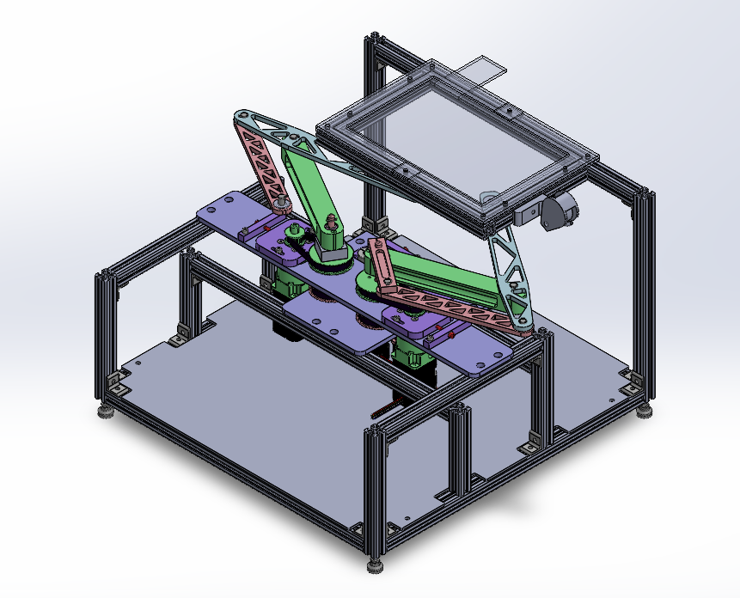
Tablet
Demo Day
Diogo, Lio, Ray, Jose, Sam and Cameron

Slide 2
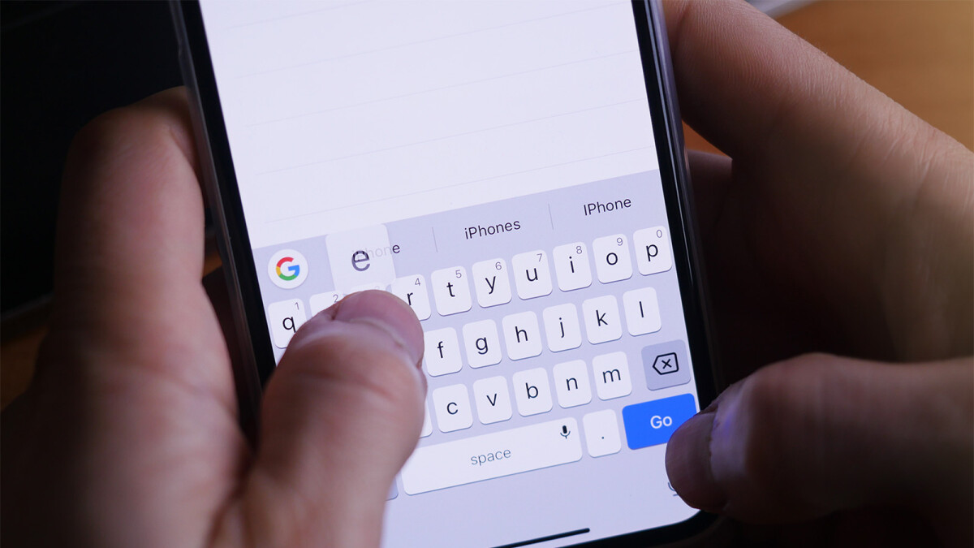
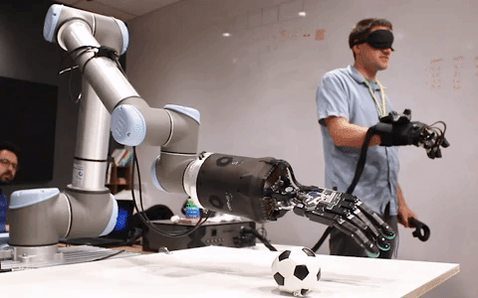
Introduction
What is a haptic device?
Machine that can simulate virtual objects with which a user may interact primarily via the sense of touch
Examples
iPhone- keyboard clicks
6DOF robotics arm with force-sensing hand and active glove
Our challenge:
Create an interactive 2D display (touchscreen) with active force feedback
Up to 6N of force on the user

Slide 3
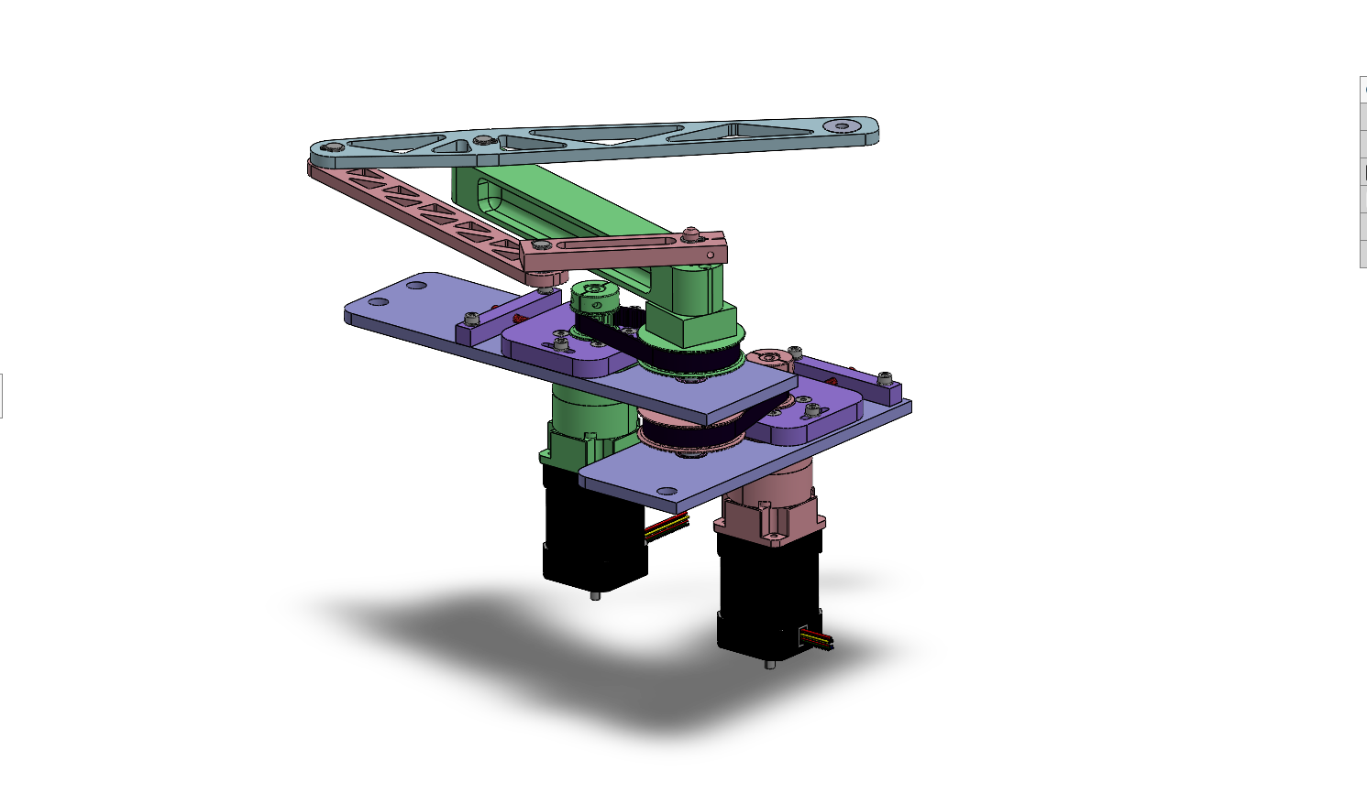
How it works
Common shaft / axis
Two, 2R parallel linkages
Magnets on the end effector go under the the screen and interact with magnets on top of the screen
Use tablet finger position data
2.5:1 XL timing belt reduction
2X 5:1 planetary gearbox
2X brushless DC motor

Slide 4
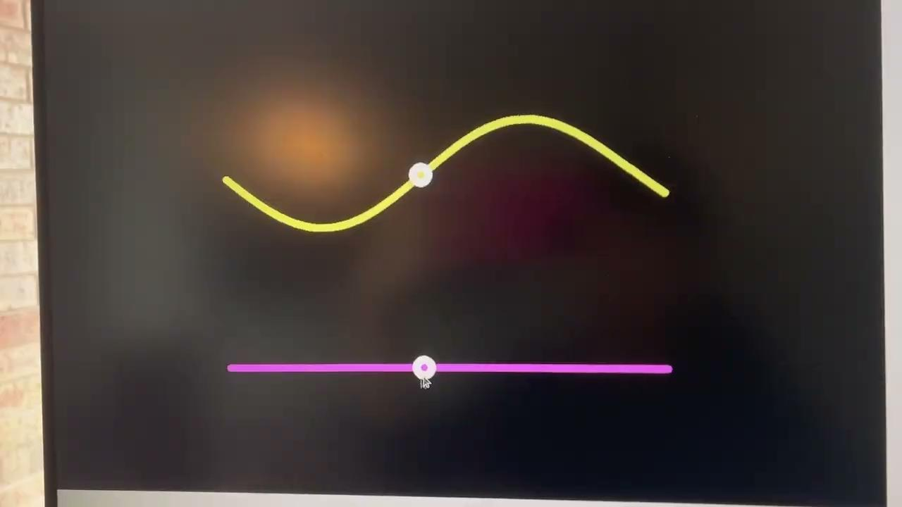
Demo 1: Sensing Functions
Translating the concept of a function into an haptic experience for visual impaired individuals

Slide 5
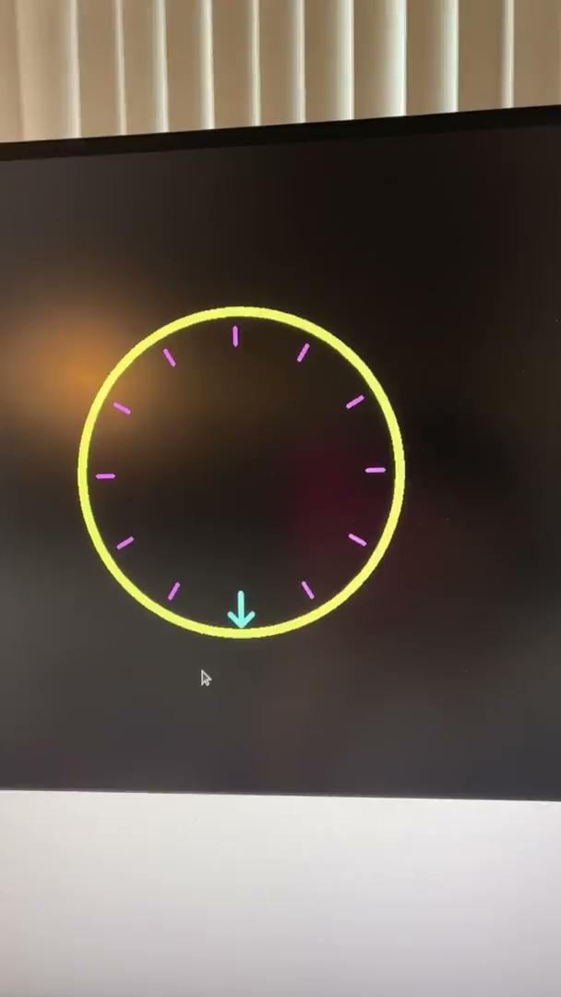
Demo 2: virtual knob
Creating the physical experience of knob on a digital screen

Slide 6
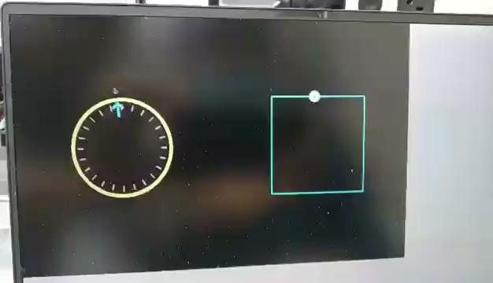
Demo 3: Knob + Shape sensing
Using a virtual knob to create the sensation of a shape

